Slide 1

La Guida Globale al Monitoraggio Partecipativo dell'Attività Mineraria

Slide 2
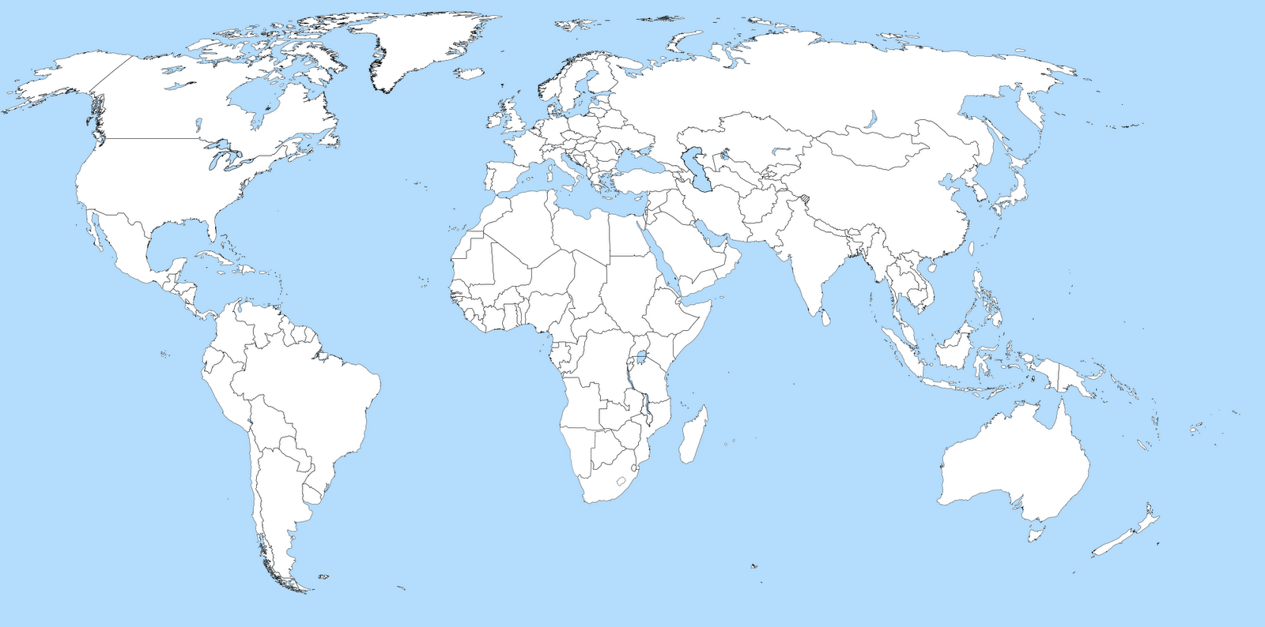





Mining
Oil & Gas
Others
Headquarters

Slide 3
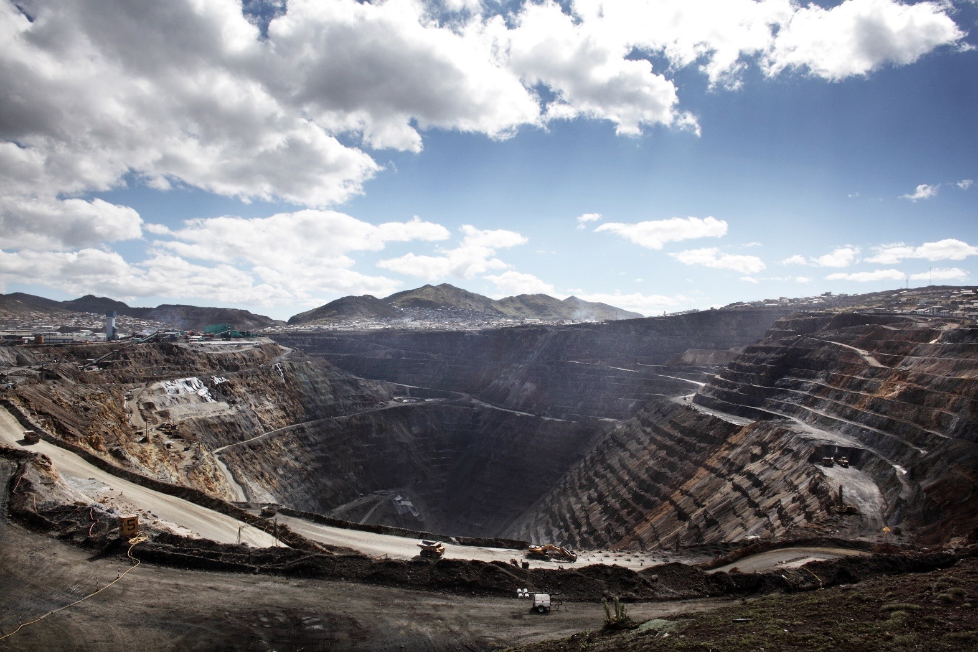

Slide 4
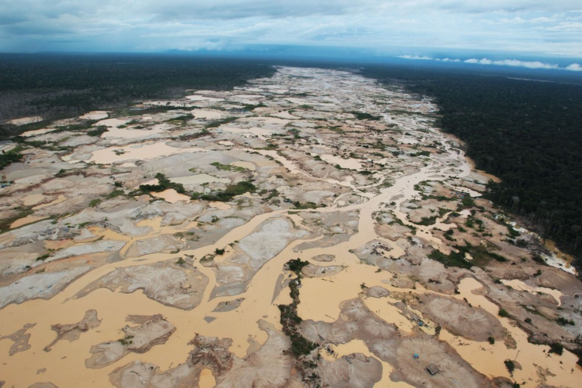

Slide 5
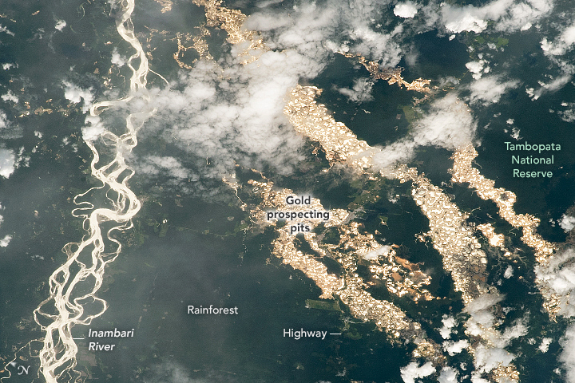

Slide 6



La Guida
Source International
Esecutore del progetto
Agenzia Svedese di Protezione Ambientale
Partner tecnico
Programma di Sviluppo delle Nazioni Unite
Finanziatore e leader del progetto

Slide 7

Direct Indirect

Slide 8
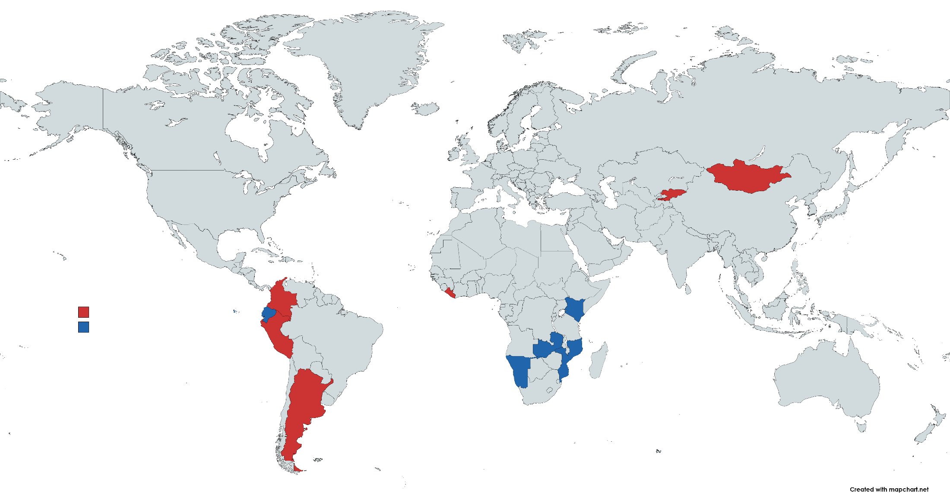

Slide 9
DRAFT CONTENT OF THE GUIDE
Chapter 1: Introduction to PEM
Chapter 2: Why doing PEM
Chapter 3: The PEM Committees (PEMC)
Chapter 4: How to conduct PEM
Chapter 5: Data and Information Management
Glossary

Slide 10
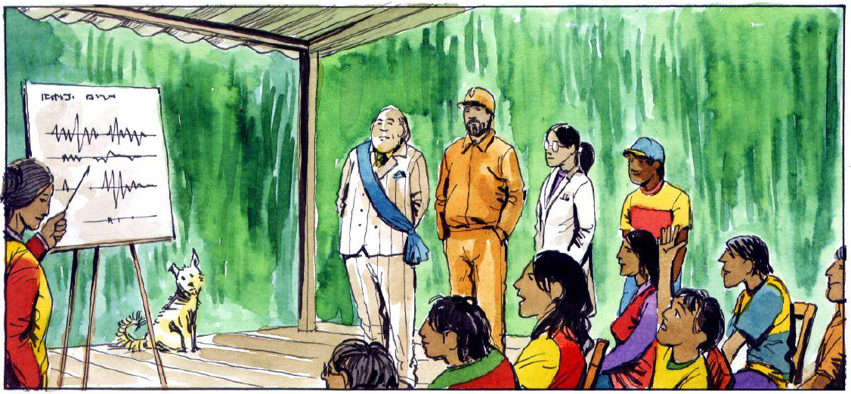
Co-creazione continua

Slide 11




Source.int
@SourceInt
@Source_Int
www.source-international.org
Mission. Provide scientific assistance to communities who will use it to defend their rights, their resources and their health.
Ashoka Fellow in 2012.
One of the 30 most innovative projects of 2012.
Finalist at Katerva Award in 2014.
Tech Award in 2014.
Unreasonable Fellow 2015.
Impact Tech Award 2016.

